Slide 1
iOS App Development Lifecycle

Slide 2
Contents
Requirements
Software
Swift
xCode
Deployment
Testflight
Demo
UITesting

Slide 3
A short notice
This e-Portfolio is not about learning swift and it’s best practices, it is simply to show how an iOS App joins the app store and which features apple provides to their developers to fulfill software engineering best practices in at least half of an hour.

Slide 4
Requirements

Slide 5
Requirements
Apple ID
Operating System OS X
License costs $99/year
(optional)
iPhone / iPad

Slide 6
Software

Slide 7
Software
On your Mac
xCode
iOS Simulator
On your iPhone / iPad
Just a non jailbreak version of iOS

Slide 8
Swift

Slide 9
Swift – Quick Facts
Object oriented language
Integrated UI framework
Great Objective-C integration
@objc func myAwesomeObjcFunction() { //Code in Objective-C }
Call by: #selector(myAwesomeObjcFunction) everywhere in Swift Code
Memory management is handled by Automatic reference counting
Notes:
Automatic reference counting manages you memory if you declare a variable. If a variable is no longer in use – this unit will free the automated allocated memory. To simplify that: it just works.

Slide 10
Swift - History
2010
Development started
Java: 1996
2014
Swift 1: First Version Release
2015
Swift 2
2016
Swift 3
2017
Swift 4
2019
Swift 5

Slide 11
Swift – Code samples
Initialization of Variables
Example
Structures

Slide 12
Swift – Code samples I
Initialization of Variable
var someFullyChangable : String = “” // has to be a String
var anotherFullyChangable : String? // could be a String
let changableProperties : People? //you can’t change the object only properties (next Slide)
let exampleInteger = 1
var containsNil: String?
let (firstString, secondString) = (“Hello”, “World”)
var couldBeAFuctionOrMore : Any
Notes:
As I told you in the beginning this should not be a swift tutorial. I’ll tell you something about variable initializing just because we need this for our demo. Swift is not that equivalent to Java or C.
Any can represent an instance of any type at all, including function types. But Any is not clearly defined, that means if we implement this into a codable or decodable structure swift will fail.

Slide 13
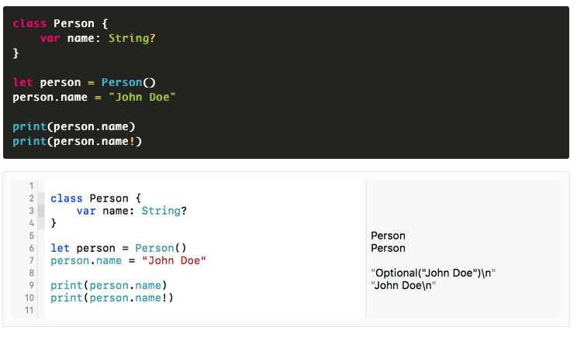
Swift – Code samples II

Slide 14
Swift – Code samples III

Slide 15
Swift – Code samples III
A sample structure:
struct People : Codable { // If you want to load a json file into var name : String your prog, you must create a var address : Address codable object
var postal : Int
var town : String
}
class DoSomething { } struct someView : View { }
Notes:
After the double point is space for an optional protocol your swift method could belong to. Every protocol has different requirements to your function. Identifiable for example needs an unique ID construct or Equatable needs a comparison function

Slide 16
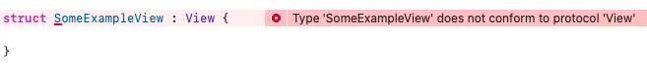
Swift – Code samples IV
Create a View structure:

Slide 17
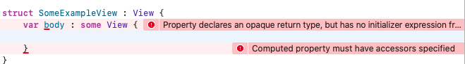
Swift – Code samples V
Add required protocol structure

Slide 18
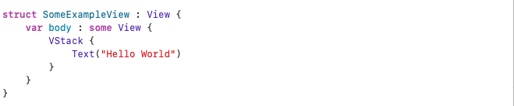
Swift – Code samples VI
Finally conform to body’s requirements and all should be fine!

Slide 19
Swift – User Interfaces
UIKit
SwiftUI
Notes:
Nothing works without a UI that’s why we need to choose between one of those two native UI implementations. There are additional implementations / frameworks available – but those are third party implementations like the SAP Fiori iOS SDK – that why they don’t matter in this e-Portfolio

Slide 20
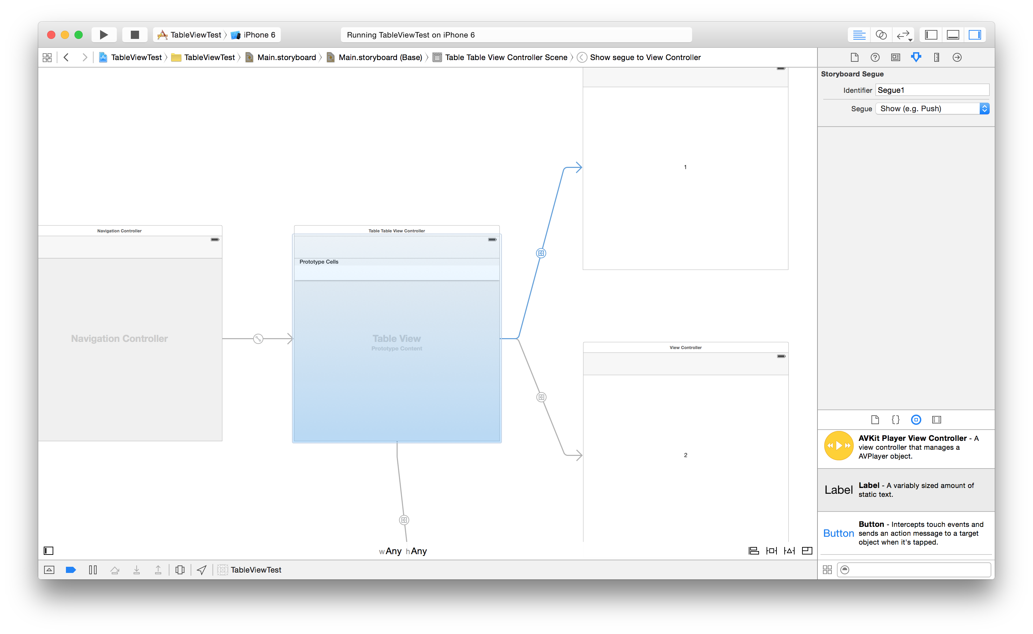
Swift - UIKit
A collection of different Controller in a “storyboard”
Storyboards got introduced in iOS 5
Add a Navigation Controller to navigate between those View Controllers
In change -> SwiftUI

Slide 21
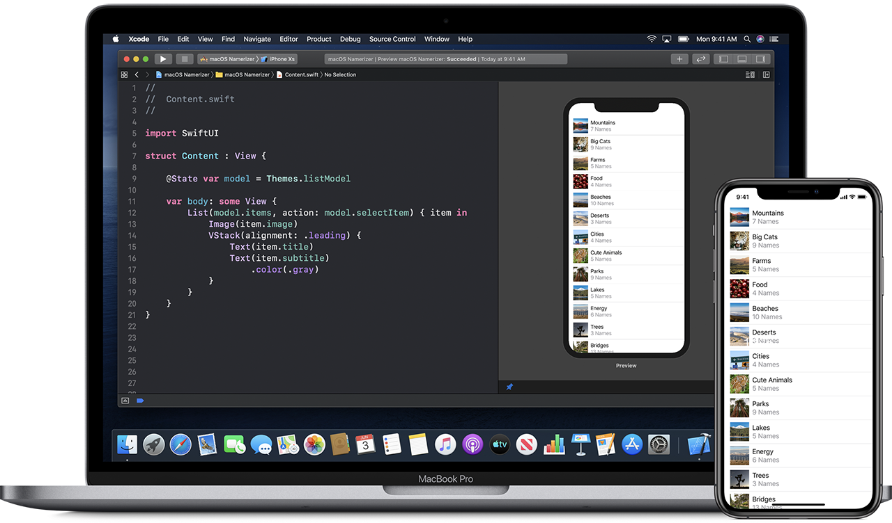
SwiftUI
Implemented since iOS 13 (actual version)
”Revolutionary” technology – Apple
Uses Code to build an UI
Label? : Text(“What you want”)
UI reacts automatically to variable changes
Notes:
TextField example

Slide 22
SwiftUI
Horziontal, Vertical and 3-rd dimension orientation by:
HStack
VStack
ZStack
Uses UI design guidelines of Apple automatically
Different font sizes, correct font
Full support for darkmodes
Perfect sizing for all Apple devices (including Mac Apps)

Slide 23
xCode

Slide 24
xCode 1/2
IDE to develop Swift and Objective-C Applications
Developed by Apple
Included Simulator for iPhone and iPad
Direct integration of git

Slide 25
xCode 2/2
Integrated UITesting
Integrated Code Testing
Live preview of UI Design

Slide 26
UI Testing

Slide 27
UI Testing
Apple implements a UI Testing library called XCTest
You can create Test classes with the project

Slide 28
Example UI Testing Code
func testCheckIfSomeThingWorks() {
// UI tests must launch the application that they test.
let app = XCUIApplication()
app.launch()
//You can simply access a button by its label / text
app.buttons[“ButtonText"].tap()
//Or test with expectations to be true or false as well as wait for a code
//For reference: chevron.up is a system icon (arrow up)
XCTAssertTrue(app.buttons["chevron.up"].waitForExistence(timeout: 10))
}

Slide 29
Testflight

Slide 30
Testflight
App in App Store to download experimental apps
You can invite up to 10.000 alpha / beta testers to test your app
App will be checked by apple -> takes up to 2 weeks

Slide 31
Testflight – Process
1. in xCode go to Product -> Archive -> wait for building -> Deploy (you will receive an error)
1
2. Go to developer.apple.com -> Create signing for your app by package name
2
3. Go to App Store Connect -> Add App to your App portfolio
3
4. Make sure that you have added an App icon – otherwise App Store Connect disables your build.
4
5. Repeat step 1, but it will work now
5
6. Go to App Store Connect -> Send required information about your app to apple -> Internal testing is allowed
6
7. Your internal testers (your co-workers) will receive an Push Notification on their mobile
7
8. After (1-2 weeks) Apple will review your app: afterwards you’ll be able to test with external alpha / beta testers
8

Slide 32
Testflight / Build – Process
1. in xCode go to Product -> Archive -> wait for building -> Deploy (you will receive an error)
1
2. Go to developer.apple.com -> Create signing for your app by package name
2
3. Go to App Store Connect -> Add App to your App portfolio
3

Slide 33
Testflight / Build – Process
1. in xCode go to Product -> Archive -> wait for building -> Deploy (you will receive an error)
1
2. Go to developer.apple.com -> Create signing for your app by package name
2
3. Go to App Store Connect -> Add App to your App portfolio
3
4. Make sure that you have added an App icon – otherwise App Store Connect disables your build.
4
5. Repeat step 1, but it will work now
5
6. Go to App Store Connect -> Send required information about your app to apple -> Internal testing is allowed
6
7. Your internal testers (your co-workers) will receive an Push Notification on their mobile
7
8. After (1-2 weeks) Apple will review your app: afterwards you’ll be able to test with external alpha / beta testers
8

Slide 34
Testflight - Features
Your participants can give direct feedback or report bugs by taking a screenshot
You see on how much devices your application is installed
You’ll get direct feedback
You’ll receive direct crash reports

Slide 35
Demo

Slide 36
What we will do
1. Create a project
4. Implement a ListView with SwiftUI
2. Implement a codable structure
5. Load mock data
3. Build the application and deploy
6. Test the application

Slide 37
Sources
Swift (May 4, 2020) https://de.wikipedia.org/wiki/Swift_(Programmiersprache)
Apple Developer (May 6, 2020) https://developer.apple.com
Objective-C (May 7, 2020) https://en.wikipedia.org/wiki/Objective-C
What is a storyboard? (May 11, 2020) https://www.hackingwithswift.com/example-code/language/what-is-a-storyboard

Slide 38
Might be helpful
SwiftRocks https://swiftrocks.com
HackingWithSwift https://www.hackingwithswift.com
Apple Developer https://developer.apple.com
RayWenderlich (iOS & Android) https://www.raywenderlich.com/ios

Slide 39

The end
By Niclas Schmuck - 2020

